Slide 1
SIML Quick Start
Version: 1.0
Only a few simple SIML features have been touched briefly in this presentation. To get into more details please visit Syn Wiki

Slide 2
Any sufficiently advanced technology is indistinguishable from magic.
- Arthur C. Clarke.

Slide 3
Getting Started
What’s this?
This is a quick start tutorial on SIML bot creation
By the end of this tutorial you will be able to create your own SIML Bot with simple functionalities
So grab a cup of coffee...
But before you begin your development download Chatbot Studio
Syn Chatbot Studio is the official IDE for SIML Bot development.
To download Chatbot Studio visit SimlBot.com
System Requirements
All of the following system requirements should be met in their entirety
Windows 7 or Above
.Net Framework 4.5
1 GB RAM
1 GB Free Disk Space
Minimum 1024x768 Desktop Resolution
All SIML 1.0 files are licensed under Apache License Version 2.0

Slide 4
Why SIML ? In three simple Words
Speed
Simplicity
Power

Slide 5
500,000 Models
1 Unique Language
100%
SIML Bots can load half a million Models in 4 Seconds
SIML is the only Chatbot Language that offers such a wide range of unparalleled features.
Freedom

Slide 6
NEW PROJECT
Let’s create your first SIML Bot

Slide 7

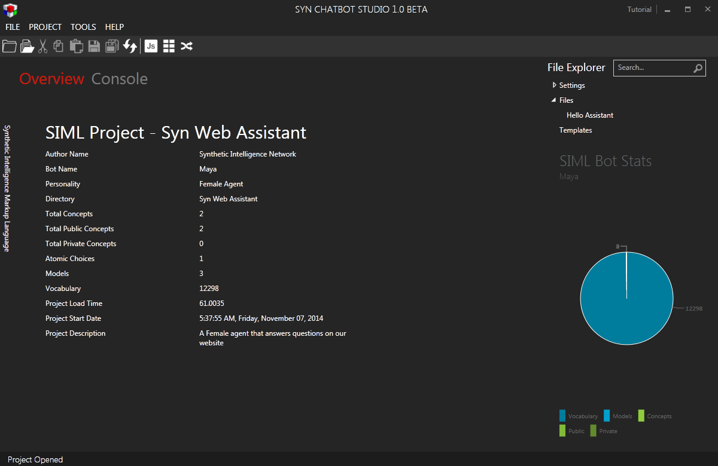
Place your screenshot here
Syn Chatbot Studio
Click File->New->Project
Fill in the details and select “Syn Web Assistant” as the base template and click “Create Project”
Type in a filename and select a directory to save your new SIML Project to and click “Save”

Slide 8

Done!
You’ve now created your first SIML Project
Whoa! well that was easy.

Slide 9
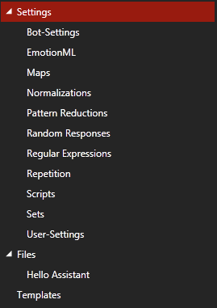
SIML Files Explorer
Settings
Bot-Settings
EmotionML
Maps
Normalizations
Pattern Reductions
Random Responses
Regular Expressions
Repetition
Scripts
Sets
User-Settings
Files
Hello Assistant
We will go through all of the above files in this presentation but the order of evaluation may not be the same.

Slide 10
Hello Assistant
Now that you have created your Project lets Chat with your new Bot.
Click on the “Console” tab and type “Hello Assistant”
Output
“Hello User!”
Explanation
When you type “Hello Assistant” a simple pattern is matched and a response is generated
SIML Code
<Siml>
<Concept Type="public" Name="Hello Assistant">
<Model>
<Pattern>HELLO ASSISTANT</Pattern>
<Response>Hello User!</Response>
</Model>
</Concept>
</Siml>
❊ SIML patterns are case-insensitive therefore if you would’ve typed “hello ASSISTANT” the response would still be the same.

Slide 11
Writing an SIML Model
Click on “Hello Assistant” file under the “Files” category
Type in the following SIML Code within the Concept “Hello Assistant”
SIML Code
<Model>
<Pattern>
<Item>HOW ARE YOU</Item>
<Item>HOW IS IT GOING</Item>
</Pattern>
<Response>I am doing great!</Response>
</Model>
Click on the Refresh button on the Toolbar or press F5
❊ Use Alt+M to insert a Model template
❊ A refresh is required to reload your changes and calibrate the Graph that SIML uses.

Slide 12
Your SIML Code
Your new SIML Code should look like the following within the Editor
SIML Code
<Siml>
<Concept Type="public" Name="Hello Assistant">
<Model>
<Pattern>HELLO ASSISTANT</Pattern>
<Response>Hello User!</Response>
</Model>
<Model>
<Pattern>
<Item>HOW ARE YOU</Item>
<Item>HOW IS IT GOING</Item>
</Pattern>
<Response>I am doing great!</Response>
</Model>
</Concept>
</Siml>

Slide 13
Testing your Bot
Click on the “Console” tab and type “how are you”
Output
“I am doing great!”
Explanation
The SIML code you just wrote now has a model with patterns “how are you” and “how is it going” that yields a response “I am doing great!”. So when the user types “how are you” this model is activated and its response is evaluated. Note the <Item> element allows multiple patterns to be declared within the same element.
We will now learn about Concepts and Models

Slide 14

SIML Concepts
A Concept is a collection of Models.
A Concept is “your” abstract idea of how the user perceives a topic while interacting with your Bot.

Slide 15
Declaring a Concept
A SIML Concept has the following attributes
Type
Public or Private.
Models within a public Concept are visible globally and will be activated whenever their patterns match.
Models within a private Concept are not visible unless a Response within a public Model activates it.
Name
Every Concept in SIML should have a name. A name is what identifies a Concept and tells the Bot what subject is under consideration. A Concept may at times be synonymous to a Topic.
Repeat
True or False
Models within a Concept may or may not repeat themselves. i.e. they may be designed to be evaluated only once. In that case a Concept is declared with an attribute Repeat=”False”

Slide 16
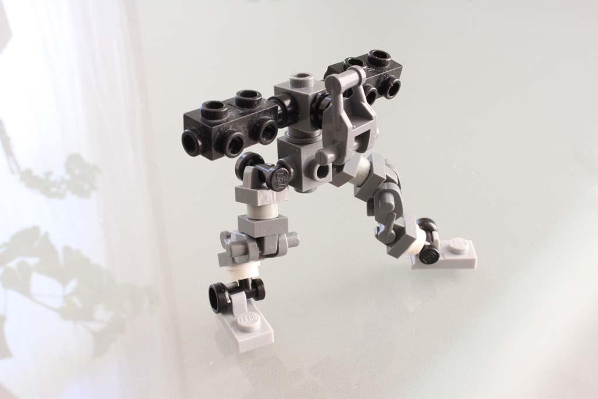
SIML Model
Basic unit of knowledge.

Slide 17
SIML Models
A basic unit of knowledge in SIML is stored within a Model
Pattern
A Pattern element holds textual patterns ( simple or complex ) that are checked when an input is received
Once a pattern is matched the Response element within the Model is evaluated.
Previous
Optionally the previous utterance of the Bot may be checked after a pattern is matched using the Previous tag.
If the previous utterance of the Bot is equal to the one specified within the Previous element then the Response element within the Model is evaluated
Response
The Response element within the Model is the part that is evaluated if it’s ancestor pattern matched the user input.
A Response element may contain other SIML elements that transform the response that is sent to the user.
❊ Models can only occur within Concepts and other Models

Slide 18
Typical example of an SIML Model
SIML Code
<Model>
<Pattern>YES</Pattern>
<Previous>Do you like Chatbots</Previous>
<Response>That is just awesome!</Response>
</Model>
“YES” is the pattern
“Do you like Chatbots” is last utterance of the Bot
“That is just awesome!” is the response that will be generated if the user types “yes” after the bot says “Do you like Chatbots”
❊ Use Alt+M to insert a Model template when using Syn Chatbot Studio
❊ All SIML tags are case-sensitive

Slide 19

SIML Pattern
A sequence of SIML tokens that activates a Model

Slide 20
SIML Pattern
A Pattern is a sequence of SIML tokens or elements that get a Model activated
Atomic
A Pattern that comprises of only words. Words maybe in any language.
Non-Atomic|Complex
A Pattern that consists of words and/or pattern symbols. There are a number of SIML Pattern elements/wildcards that can be used to declare a non-atomic pattern
Conditional
A Pattern that consists an <If> element that specifies a condition to be evaluated
Scripted
A Pattern that consists a condition specified in a scripting language that, when evaluated, returns True or False
❊ Conditional and Scripted patterns shouldn’t be used inside Public Concepts

Slide 21
Pattern Elements in SIML
^ (up arrow) - Is prefixed to a word and makes SIML Bot search for the preceding word before any other pattern element. Example “^Run Console” will match “Run Console”
% (percent) - Matches zero or more words. Example “Do you like %” will match “Do you like cupcakes” or “Do you like bacon”
_ (Underscore) - Matches one or more words. Example “What is _” will match “What is a conscientious man” or “what is your name”
Atomic - These are word based patterns and contain no symbols. Example “How are you” will match exactly “how are you” or “HOW are YoU” as user input is case-insensitive to an SIML Bot.

Slide 22
Pattern Elements in SIML
@Regex - Denotes an pre-defined regular expression. Example “Switch @Switch” where Switch can be any regular expression say with the pattern “\b(on|off)\b” and will match the sentence “Switch on” or “Switch Off”
$ (dollar) - Matches one or more words but has a lower priority than %. Example “What do you $”
{Word1 Word2 Word3} - Is a keywords based pattern and matches the word in the given order even if intermediary words exists within the specified sequence of words. Example “{what your name}”will match “what is your name”
[SET] - A Set is a collection of words stored in the Settings File. Example “I like the color [COLOR]” will match sentences like “I like the color red” , “I like the color blue” or “I like the color green”

Slide 23
Pattern Elements in SIML
(Word1|Word2|Word3) - A Dynamic set that stores related words. Example “I like the color (Red|Green|Blue)” will match “I like the color red” or “I like the color green” or even “I like the color blue
<If> (Conditional) - a conditional pattern in SIML is activated if the condition within the If element is satisfied or returns true. Example <If User=”Age” Value=”26”/> will match if the age of the user is 26 and will activate the underlying Model.
<Js> (Scripted) - A Scripted pattern contains a code in a scripting language and if True is returned upon evaluation the Model is activated. Example <Js>isValid();</Js>. SIML Bot offers JavaScript as the default Scripting Language and has an in-built JavaScript interpreter.
* (Star) - Matches one or more words and has the lowest priority in the evaluation tree. Example pattern would “How are you *” will match “How are you today” but wouldn’t match “how are you”

Slide 24

SIML Response
A Response is the final output a bot returns after evaluating an input
Responses may or may not contain a textual value and encapsulate one or more SIML elements

Slide 25
Creating a Concept and a Model with patterns
Right click on “Files” under Files Explorer and select “Add New File”
Type “My First Concept” and press OK
SIML Code
<Siml>
<Concept Name="Hello Assistant" Type="public" Repeat="True" ></Concept>
</Siml>
Click just before </Concept> and press Alt+M to insert a new Model template
Type the following SIML Code
SIML Code
<Model>
<Pattern>WHAT IS A *</Pattern>
<Response>What do you think a <Match /> is?</Response>
</Model>
❊ Press Alt+I to indent the SIML document

Slide 26
Test your SIML Code
Click on the Console tab and type “what is a Car”
The Bot replies “What do you think a Car is?
Wildcard
Whenever you use a wildcard one or more word are matched and a value is stored in an indexed stack.
<Match/>
To access the captured word or sets of words you may use the Match tag. The first capture is stored at Index 1 and then Index 2, Index 3 and so on. The Index can be accessed using the “Index” attribute.
SIML Code (Example)
<Model>
<Pattern>Does * like *</Pattern>
<Response>Yes <Match /> likes <Match Index="2"/></Response>
</Model>
For the above code if the user writes “Does Sarah like nascar” the Bot will reply “Yes Sarah likes nascar”
❊ Press Alt+I to indent the SIML document

Slide 27
Keywords as patterns
Type the following SIML Code within your newly created concept
SIML Code
<Model>
<Pattern>{YOUR NAME}</Pattern>
<Response>My name is <Bot Get="Name" /></Response>
</Model>
Type “What is your name?” in the Console
The Bot will reply “My name is Syn Web Assistant”
Keywords
Sometimes its very convenient to use keywords to declare a pattern. Keywords based pattern saves a lot of time but has a penalty of being extremely ambiguous. Keywords in SIML ( within the pattern tag ) should be enclosed within curly brackets. Note:
A keyword based pattern will match if the the sequence of words occurs within the user input even if multiple words exist before, between or even after the keywords declared.
❊ Values for the Get attribute for a Bot element are case-insensitive

Slide 28
_ Underscore wildcard
Type the following SIML Code within “My First Concept”
SIML Code
<Model>
<Pattern>WHAT IS THE MEANING OF _</Pattern>
<Response>
<Goto>Define <Match /></Goto>
</Response>
</Model>
<Model>
<Pattern>WHAT IS THE MEANING OF *</Pattern>
<Response>I don't really know.</Response>
</Model>
<Model>
<Pattern>DEFINE LIFE</Pattern>
<Response>42</Response>
</Model>
❊ Patterns in SIML are case-insensitive
❊ From this point on we will no longer have sections showing the entire SIML code for readability

Slide 29
_ Underscore wildcard explained
Type “What is the meaning of Life?” in Console
The Bot replies “42”
Underscore wildcard and priority
The _ wildcard has a priority higher than the * wildcard and therefore the Model with the _ wildcard is activated instead of the Model with the * wildcard.
Once the Model is activated the <Goto> tag is used to redirect the pattern search to simpler pattern i.e. “Define” followed by whatever is matched by the _ wildcard. So the new search becomes “Define Life”. The “Pattern Reductions” file under the “Settings” category in your SIML project is to group multiple pattern reductions just like the one you wrote previously.
SIML Code
<Goto>Define <Match /></Goto>
❊ Pattern Reductions file should be used to store all pattern redirections that involve <Goto> or <GotoMatch/> elements

Slide 30
SIML Pattern elements
Priority of Pattern elements in SIML
^ ( Up arrow ) [Rank 1]
Has the highest priority
If ( Conditional ) [Rank 2]
A Conditional Pattern in SIML ranks second in the pattern search
Js ( Scripted ) [Rank 3]
A Scripted pattern is evaluated after the search for a conditional pattern ends
% ( Percent ) [Rank 4]
Matches zero or more words
_ ( Underscore) [Rank 5]
Matches one or more words
Word [Rank 6]
A word in any language within the pattern tag
[Set] [Rank 7]
A collection of words grouped under a single name
(Word1|Word2) [Rank 7]
A Dynamic set has the same rank as a normal Set and are treated as such
@Regex [Rank 8]
Regular Expressions are evaluated after Sets
$ (Dollar Sign) [Rank 9]
Matches zero or more words but has a lower priority than %
{Word1 Word 2} [Rank 10]
Keywords are evaluated just before the final wildcard *
* ( Asterisk) [Rank 11]
Matches one or more words and has the least priority
❊ Not all pattern types have been discussed in this presentation

Slide 31
Regular Expressions in patterns
Click on “Regular Expressions” under “Settings” category and type the following within the SIML element.
SIML Code
<Regex Name="switch" Pattern="\b(on|off)\b"/>
Now click on “My First Concept” file under “Files” category and type the following SIML Code within the Concept
Press F5 to refresh the Project
SIML Code
<Model>
<Pattern>Switch it @switch</Pattern>
<Response>Switched <Match /></Response>
</Model>
❊ The name of a Regex should be unique

Slide 32
Test your Regular Expression
Type “Switch it off” in the Console and press Send
The Bot replies “Switched off”
Type “Switch it On” in the Console
The Bot replies “Switched On”
Regular Expressions
Regex in SIML requires a Name and ofcourse a regex pattern. SIML Bot internally optimizes your regex to work at peak performance during a chat session.
SIML Code
<Regex Name="switch" Pattern="\b(on|off)\b"/>
In the above code the name “Switch” is used to give a regex pattern a unique name and the regex pattern itself is declared as a value for the Pattern attribute
A declared regular expression can be used within a pattern by prefixing the name of the regular expression ( set by you ) with an at symbol. Example @Switch
❊ Regex names are case-insensitive

Slide 33
Sets in patterns
Click on “Sets” under “Settings” category and type the following within the SIML tag
SIML Code
<Set Name="Color">
<Item>Red</Item>
<Item>Green</Item>
<Item>Blue</Item>
</Set>
Now click on “My First Concept” file under “Files” category and type the following SIML Code within the Concept
Press F5 to refresh the Project
SIML Code
<Model>
<Pattern>I like the color [Color]</Pattern>
<Response>I like <Match /> too</Response>
</Model>
❊ Press Alt+T to insert an <Item> tag
❊ Declared Sets should always be stored in the Sets file under the Settings category

Slide 34
Test your Set
Type “I like the color red” in the Console and press Send
The Bot replies “I like red too”
Type “I like the color BLUE” in the Console
The Bot replies “I like BLUE too”
Sets
A Set in SIML is a collection of simple words. Words that group entities/nouns. Example: a Set Weekday will contain Sunday, Monday, Tuesday and so on. Large sets have no impact on SIML processing speed and are limited by your computer’s memory (RAM).
To declare a set you should give the Set a unique name using the Name attribute. Set items are stored within the <Item> tag
SIML Code
<Set Name="Color">
<Item>Red</Item>
<Item>Green</Item>
<Item>Blue</Item>
</Set>
Greedy
SIML sets are greedy i.e. SIML Bot tries to find the best match in a set
❊ Set names are case-insensitive.

Slide 35
Nested Modelling
Models within Models
In SIML Models can occur with other Models. The behaviour of such a nested structure is as if the Models were connected using independent <Previous> elements that had the Response of the Parent Model as its value.
SIML Code
<Model>
<Pattern>START APPLICATION</Pattern>
<Response>Are you sure ?</Response>
<Model>
<Pattern>Yes</Pattern>
<Response>Application started.</Response>
</Model>
<Model>
<Pattern>No</Pattern>
<Response>As you wish.</Response>
</Model>
</Model>
Add the above SIML code to your current Concept in your Project.

Slide 36
Test your Nested Models
Type “Start application” in the Console and press Send
The Bot replies “Are you sure”
Type “Yes” in the Console
The Bot replies “Application Started”
Repeat the steps but this time say “No”
And the Bot will reply “As you wish.”
Behaviour
Models within Models is a special technique to avoid writing multiple <Previous> elements whenever you wish to refer to the last output of the Bot. Nested Models do not take the previous utterance of the Bot into consideration instead they check if the Parent Model was activated by the previous user input.
Nested Modelling should be used if the response generated by the Parent Model does not belong to a general Concept. Nested Models also eliminate the requirement of a <Label> element if the Parent Model generates a random response.
❊ More information is available in Wiki

Slide 37

Settings
A Setting in SIML is a collection of Variables that are stored in relation to its owner ( Bot or User )
Some variable names are reserved by default and are used to manipulate the behaviour an SIML code

Slide 38
Bot Settings
Variables of a Bot
Click on “Bot-Settings” under the Settings category in Files Explorer
BotSettings
The BotSettings element acts as a container for all Bot related variables ( or predicates ). A Variable in SIML should have a name and can have 1 or more values. Some variables can be left “undefined” meaning that they exists but have no values in them.
Type in the following Code within the BotSettings element
SIML Code
<Variable Name="sleep-time" Value="11pm"/>
❊ Variable names should be unique and names that require 2 or more words should be separated by a hyphen.

Slide 39
Bot Settings
Getting a Variable
Click on “My First Concept” and type the following SIML Code
SIML Code
<Model>
<Pattern>WHEN DO YOU SLEEP</Pattern>
<Response>I sleep at <Bot Get="sleep-time" /></Response>
</Model>
Type “when do you sleep” in Console
The Bot replies “I sleep at 11pm”
Get
The Get attribute takes a variable name as its value and returns the value of the variable specified. A variable name is case-insensitive in SIML but by convention use - ( hyphen ) to separate individual words in a variable name.
❊ Always remember to Press F5 to refresh your project once you’ve made changes to any SIML document

Slide 40
Bot Settings
Setting a Variable
Replace the previous SIML code with the following
SIML Code
<Model>
<Pattern>WHEN DO YOU SLEEP</Pattern>
<Response>I sleep at <Bot Get="sleep-time" />
<Think>
<Bot Set="sleep-time">12am</Bot>
</Think>
</Response>
</Model>
Type “when do you sleep” in Console
Bot Replies “I sleep at 11pm”
Type again “When do you sleep” in Console
Bot Replies “I sleep at 12am”
Set
The Set attribute is used to set a value for a variable ( that may or may not be defined ). The <Think> tag in the code above is used to silence the output by the Bot element which would otherwise return 12am

Slide 41
User Settings
Variables of a User
Click on “User-Settings” under the Settings category in Files Explorer
UserSettings
Just like the BotSettings tag the UserSettings acts as a container for all User related variables. All values defined within the User-Settings files are considered default for all newly created users. And help the bot to assume some information regarding the user it may interact with.
Just like BotSettings you can use variables within UserSettings
SIML Code (Example)
<Variable Name="Middle-Name" Value="Edward"/>
SIML Code (Example)
<Variable Name="favorite-movies">
<Value>Contact</Value>
<Value>Godfather</Value>
<Value>Green Miles</Value>
<Value>Life Is Beautiful</Value>
</Variable>

Slide 42
User Settings
Getting a Variable
Click on “My First Concept” and type the following SIML Code
SIML Code
<Model>
<Pattern>What is my middle name</Pattern>
<Response>It’s <User Get="middle-name" /></Response>
</Model>
Type “what is my middle name” in Console
The Bot replies “It’s Edward”
Setting a Variable
Like the Bot tag the User tag can be used to set a value for a user variable using the Set attribute whose value should be a variable name.
SIML Code
<Model>
<Pattern>My name is *</Pattern>
<Response>Hi there! <User Set="Name"><Match /></User></Response>
</Model>
❊ Both Bot and User tags have the same set of operations

Slide 43

Normalization
Normalization in SIML involves filtration of unimportant words or symbols, replacement of words and splitting of user message into multiple Inputs

Slide 44
Normalization
SIML Normalization elements
Filter
A Filter in SIML is used to replace characters or words in user input or output
Filters are of 3 types
Input
Output
Both
Splitter
A Splitter in SIML is used to split the user message into multiple sentences wherever certain characters are found.
<Text>, <Word> and <Regex>
These 3 tags can be used within a Filter or a Splitter element
<Text> denotes a sequence of characters
<Word> denotes an actual word
<Regex> a regular expressions that match complex sequence of characters

Slide 45
Filter
Creating a very simple Filter
Click on “Normalizations” under the Settings category and type the following within the SIML element
SIML Code
<Filter Value="bla">
<Word>bla bla</Word>
</Filter>
In the code above we create a Filter by using the <Filter> tag and add a <Word> tag with the value bla bla. The Value attribute in the above filter will be used as the replacement text that will replace all occurrences of the words “bla bla” with just “bla” Complexity
Filtration is not a simple task and requires planning. Planning of filtration is required in complex projects because the developer has to take into consideration the usage of Regular Expressions and has to make sure certain characters or words are not filtered out.

Slide 46
Test your Filter
Click on “My First Concept” file under Files and type the following SIML Code
SIML Code
<Model>
<Pattern>BLA</Pattern>
<Response>What!</Response>
</Model>
Type “bla bla” in Console
The Bot replies “What!”
As filtration takes place before an Input is processed your input “bla bla” is filtered out and is replaced with “bla” and that is why the above Model gets activated.
Types
As the Filter you defined previously has no Target attribute it is assumed to be an Input filter. Input filters only replace user inputs. There is also an option to create an Output filter which filters out Bot messages.

Slide 47
Splitter
A Splitter simply splits the user message into multiple sentence wherever the specified character, word or even a regex is matched. Typical English Splitter
We recommend using just . (dot) and ?(question mark) as the 2 textual characters in Splitters if you are developing an English/French/Spanish/ Bot.
SIML Code
<Splitter>
<Text>.</Text>
<Text>?</Text>
<Text>!</Text>
<Text>;</Text>
</Splitter>
The above Splitter code is already present within the SIML element in the file “Normalizations”. You may notice that we have used <Text> tags above and this is to tell the SIML bot that wherever the characters ( not words ) are found the sentence should be split.

Slide 48
Test sentence splitting
Click on “My First Concept” file under Files and type the following SIML Code
SIML Code
<Model>
<Pattern>HOW ARE YOU</Pattern>
<Response>I am fine thank you.</Response>
</Model>
<Model>
<Pattern>ANYTHING NEW</Pattern>
<Response>Yes a lot has changed now.</Response>
</Model>
Type “how are you? anything new?” in Console
The Bot replies “I am fine thank you. Yes a lot has changed now.”
The user input is split into “how are you” and “anything new” because of the character “?” which has already been declared as the splitting character within the Splitter element discussed earlier.

Slide 49

Randomness
Random responses make your Bot feel more humanely by generating unique random outputs for the same set of pattern.

Slide 50
Random Response
There are 2 types of Random response elements in SIML
Random
Under this element individual responses are saved using the <Item> tag and whenever the Random element is evaluated after a Model is activated the Random element returns a random item from the list within it.
Phrase
Similar to a Random element but instead of just selecting a random element the Phrase element selects the item within its list that best matches the user input. But in some cases the Phrase element will return a Random value if the “Word Distance” is approximately the same for all listed items.

Slide 51
Creating a Random Response
Replace previous Model with the pattern “how are you” with the following SIML Code
SIML Code
<Model>
<Pattern>HOW ARE YOU</Pattern>
<Response>
<Random>
<Item>I am doing great</Item>
<Item>I am fine thank you.</Item>
<Item>Never been better</Item>
<Item>Fine. How are you?</Item>
</Random>
</Response>
</Model>
Type “How are you?” in the Console
A random answer is generated
Type “How are you?” again in the Console
A random answer is generated
❊ Pressing Alt+R inserts a Random element template

Slide 52
Creating a Predictive Response
Type in the following SIML Code
SIML Code
<Model>
<Pattern>
<Item>WHAT IS YOUR NAME</Item>
<Item>WHAT CAN I CALL YOU</Item>
</Pattern>
<Response>
<Phrase>
<Item>My name is <Bot Get="Name" /></Item>
<Item>You can call me <Bot Get="Name" /></Item>
</Phrase>
</Response>
</Model>
Type “What is your name?” in the Console
Bot replies “My name is Syn Web Assistant”
Type “What can I call you?” in the Console
Bot replies “You can call me Syn Web Assistant”
❊ Press Alt+P to insert a Phrase element template
❊ Multiple patterns can be grouped within the same Model using the <Item> tag

Slide 53
Reusability - Random Response
Random Responses file
Under the Settings category you will see the “Random Responses” file. This file is used to save Random responses for later usage. To save a Random/Phrase element for later reuse add a Random element and give it a unique name for identification using the “Name” attribute. Later on you can reuse the Random element using the “Get” attribute.
Type the following Code within the “Random Responses” file
SIML Code
<Random Name="I-am-fine">
<Item>I am doing great</Item>
<Item>I am fine thank you.</Item>
<Item>Never been better</Item>
<Item>Fine. How are you?</Item>
</Random>
Replace your Random element in the previous Random example with the Code below and the Bot’s response should remain the same.
SIML Code
<Random Get="i-am-fine" />

Slide 54

Scripting
True power of Scripting

Slide 55
Scripts in SIML
SIML gives Scripts the true power
Language
Scripts in SIML 1.0 are written using JavaScript as SIML Bot has its own JavaScript Interpreter that complies with ECMA-5.1. You may use a script within the following SIML tags.
Within <Pattern>
A Script can be used within a Pattern and if the result of evaluation returns True the Model is activated
Within <Previous>
Scripts inside a Previous element are evaluated even before a Pattern is evaluated
Within <Response>
Scripts inside a Response tag can be used to generate complex responses.
If you are planning to use Scripts in Patterns we highly recommend using them inside either a Concept that is declared private or within a Model that contains a Previous tag
❊ Scripts are usually slower when compared to SIML elements and therefore should be used when absolutely necessary

Slide 56
Writing your first Script in SIML
Click on the file “Scripts” under the Settings category”
Replace the example script with the following
SIML Code
<Script Type="javascript">
function helloScript(){
return "Hello from Js!";
}
</Script>
We have now created a “Global” JavaScript that can be called at runtime. The above script is extremely simple in nature and you would probably use a much more complex function while developing an SIML Bot. All global scripts should be stored within this “Scripts” file. The Type attribute for SIML 1.0 should always be set to “JavaScript”.
We will now test our JavaScript inside an SIML response.
❊ Signatures of a global Scripts are evaluated once during startup and can be reused during a Chat session

Slide 57
Calling a Script
Click on the file “My First Concept” under the Files category
And type the following SIML Code
SIML Code
<Model>
<Pattern>HELLO JAVASCRIPT</Pattern>
<Response>
<Js>helloScript();</Js>
</Response>
</Model>
Type “Hello javascript” in Console
Bot replies “Hello from Js!”
Your globally declared function can now be reused whenever required. Additionally you could also type the globally declared JavaScript within the Js element and the response would still be the same.
For more details on how Scripts can be used within Patterns and Responses refer Wiki
❊ Js tag is used to execute a JavaScript

Slide 58
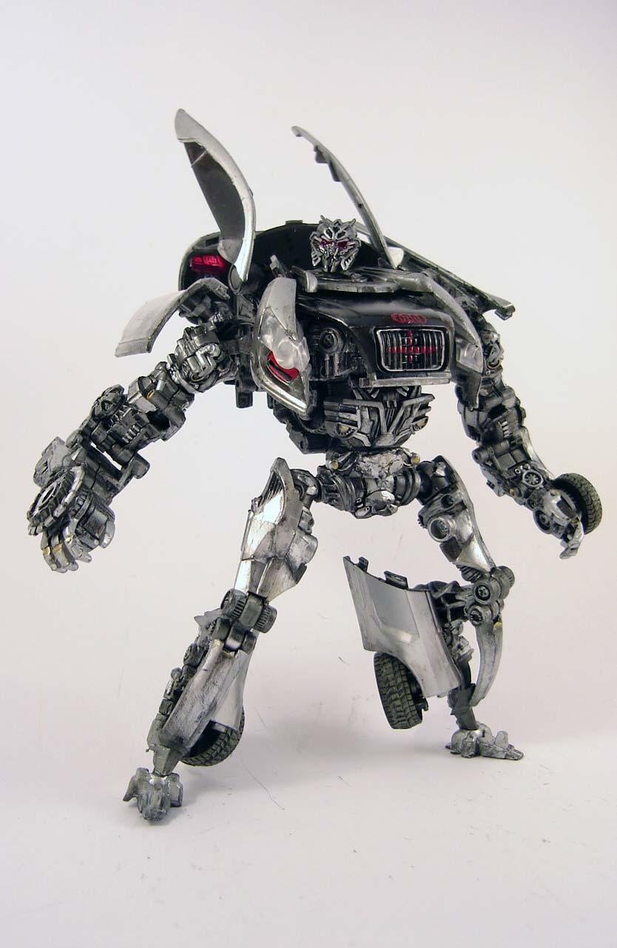
Maps
Transforms a collection of words that belongs to one set into an element of another

Slide 59
Maps
Click on the file “Maps” under the Settings category
And add the following SIML Code
SIML Code
<Map Name="person2">
<MapItem Content="like you" Value="like me" />
</Map>
Now add the following SIML Code within “My First Concept”
SIML Code
<Model>
<Pattern>I LIKE CHATBOTS *</Pattern>
<Response>
That's great that you like chatbots <Map Get="person2"><Match /></Map>
</Response>
</Model>
Type “I like chatbots like you” in Console
The Bot replies “Thats great that you like Chatbots like me”

Slide 60
Maps
Usage
Maps comes in handy when textual transformations are required. Example a Map Number2Word may transform 1, 2, 3 and so on to One, Two, Three. They can also used for pronoun substitutions say first-person to second-person or second-person to first-person.
Default English Project template in Syn Chatbot Studio comes with many regularly used Maps. To get a Map use the Map tag and specify the name of the map using the Get attribute.
SIML Code (Example)
<Map Get="person2"><Match /></Map>
Map operations are extremely fast and larger Maps have no impact on the performance of the Bot
❊ Map names are case-insensitive

Slide 61
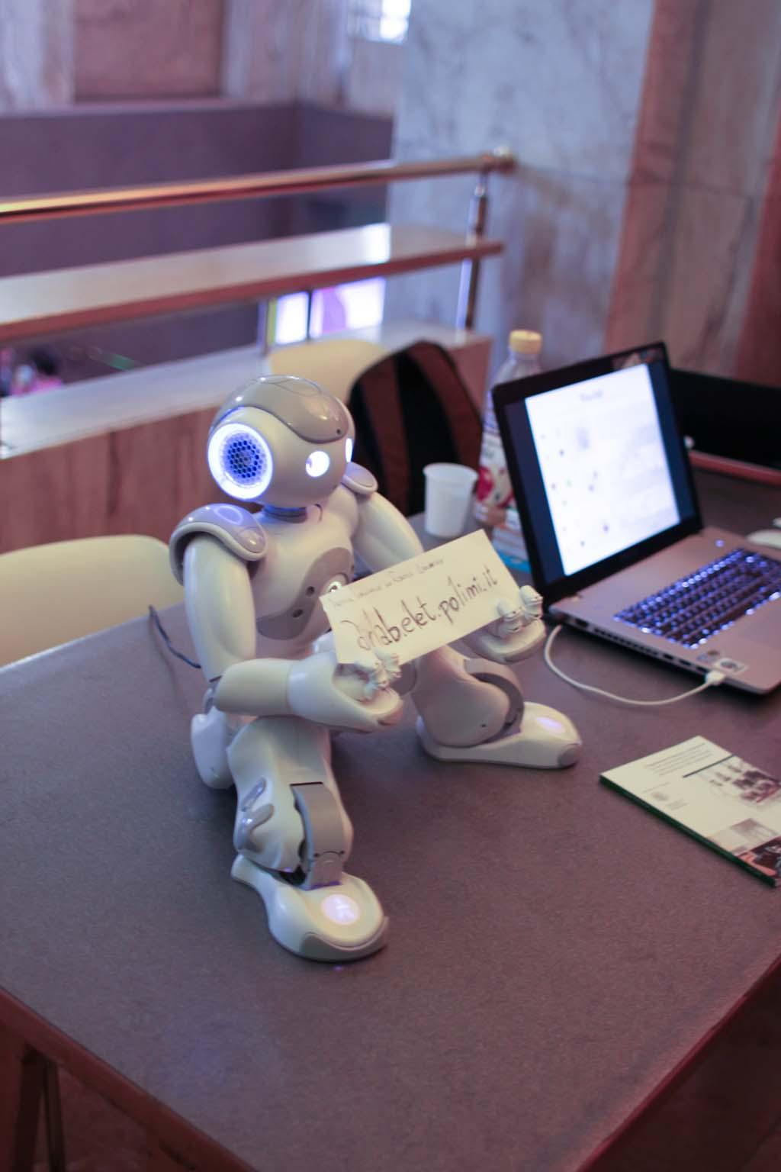
Repetition
SIML’s Repeat Management allows developers to manage repeated user inputs within Non-Repeatable Concepts

Slide 62
Repeat Tag
Repetition
In SIML a repetition is not what the user repeats but its what the Bot has to repeat to answer a chat request. This is because there are number of ways in SIML to get a Model activated and a lot of sentences may hold the same meaning. SIML addresses repetitive user requests using a unique mechanism where the Bot checks what the Bot had to repeat, if the repeated output belonged to a Non-Repeatable Model and how many of the Non-Repeatable Models were activated. Repetition Management is an advanced topic and therefore we encourage you to refer the Wiki before diving deep into it. We will now look at an example SIML code that handles repetition using the <Repeat> and <Echo> tags.
❊ An SIML Project can have just one <Repeat> element. Multiple occurrences will override existing mechanisms

Slide 63
Repetition Management
SIML Code
<Repeat>
<Response>
<If User="partial-repeat">
<Switch User="repeat-count">
<Case Value="1">And I have already mentioned <Echo Index="1" /></Case>
<Case Value="2">And I think you already know <Echo Index="1" /> and <Echo Index="2" /></Case>
<Case Value="3">And If you recall our conversation you would know <Echo Index="1" />, <Echo Index="2" /> and <Echo Index="3" /></Case>
<Default>And I do not like to repeat myself.</Default>
</Switch>
</If>
<Else>
<Switch User="repeat-count">
<Case Value="1">I have already mentioned <Echo Index="1" /></Case>
<Case Value="2">I think you already know <Echo Index="1" /> and <Echo Index="2" /></Case>
<Case Value="3">If you recall our conversation you would know <Echo Index="1" />, <Echo Index="2" /> and <Echo Index="3" /></Case>
<Default>I do not like to repeat myself.</Default>
</Switch>
</Else>
</Response>
</Repeat>
❊ This is a template SIML code and is available by default in all SIML projects

Slide 64
Repetition
<Repeat> and <Echo>
In the previous code we check if part of the user’s input activated some ( not all ) Non-Repeatable Models and if it did then we later check how many of the Non-Repeatable Models were activated.
Using the <Echo> tag we tell the user what was previously mentioned ( this Echo may not be the exact output the Bot generated last time as its a fresh response from a Non-Repeatable Model ). If you are unsure as to how repetitions are Managed in SIML we recommend leaving the Code as such if you are developing an English Bot.
❊ A few SIML elements are Not valid within a Repeat element

Slide 65
Conclusion
We have barely scratched the surface with this presentation and we highly recommend that you go through SIML Wiki to create intelligent Bots.

Slide 66






Wrapping it all
Wiki
Syn Wiki elaborates all of the concepts discussed in this documentation. So if you need more details you know exactly where to look for.
Studio
Syn Chatbot Studio is the official IDE and the main playground for working with SIML projects.
Forum
If you have any questions or suggestions Syn is open to you. Unleash the Synner in you and get together with us at Forum.Syn.co.in
SIML
SIML will always be improved and any specification changes will not hamper your development as our IDE will automatically upgrade the projects for you.
AI Freedom
All SIML knowledge base templates are free for both Commercial and noncommercial applications. To give the users the true Power SIML files are licensed under Apache License Version 2.0
0 Redundancy
With SIML we aim to eliminate the decade old code redundancy using automated tools and analysis.

Slide 67
Presentation Version 1.0 2014-12
Products and Specifications used in this documentation
Specification: SIML 1.0
Software: Syn Chatbot Studio 1.0 Beta
You can download all SIML Projects for Free and make changes:
https://github.com/SynHub
Licenses involved with SIML and its derivatives
SIML Files - Apache License Version 2.0
SIML Bot 1.0 [C# Portable] - Syn Freeware License
Syn Chatbot Studio 1.0 Beta - Syn Freeware License
All SIML files are licensed Apache License Version 2.0. Visit http://www.apache.org/licenses/LICENSE-2.0 for more details.

Slide 68
Thanks!
Any questions?
Visit: Forum.Syn.co.in
Synthetic Intelligence Network

